Slide 1
Weight Loss Medications: Current Challenges and Emerging Therapies in Primary Care
Focus on GLP-1 Based Therapy
Tasma Harindhanavudhi, MD
Division of Diabetes, Endocrinology and Metabolism
Department of Medicine
Minnesota Medical Association Forum
April 23, 2025

Slide 2

Disclosure
I have no financial disclosure relevant to this topic.

Slide 3
Case
48 years old woman with prediabetes, hyperlipidemia and asthma referred to weight management clinic.
Weight history: overweight since adolescent. Gained more weight during COVID pandemic from being at home, poor lifestyle food choice and alcohol and having peri/postmenopausal symptoms (mood swing and body ache).
Gained from ~230 lbs in 2017 to 270 lbs in 2024.

Slide 4
Case (Cont’)
Eating habit: eat on the go, no regular schedule, skipped meal due to her work, large meal at dinner, snack throughout the day
Attempts: work on healthy food choice, MyFitnesspal – not successful
Work as a realtor
Exercise: active but no regular exercise
Weight 272 lbs, height 5’5”, BMI 45 lg/m^2

Slide 5
Objectives
Upon completion, participants will be able to
1) Understand the currently available weight loss medication focusing on GLP-1 therapy
2) Discuss the side effects and safety concerns of GLP-1 and future trends
3) Apply practical strategies for primary care management

Slide 6
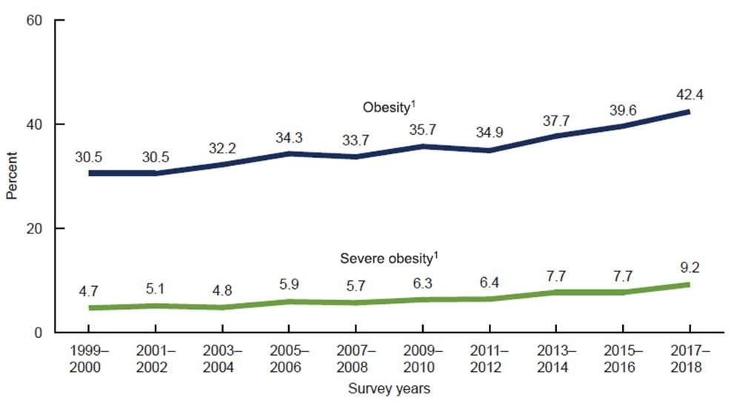
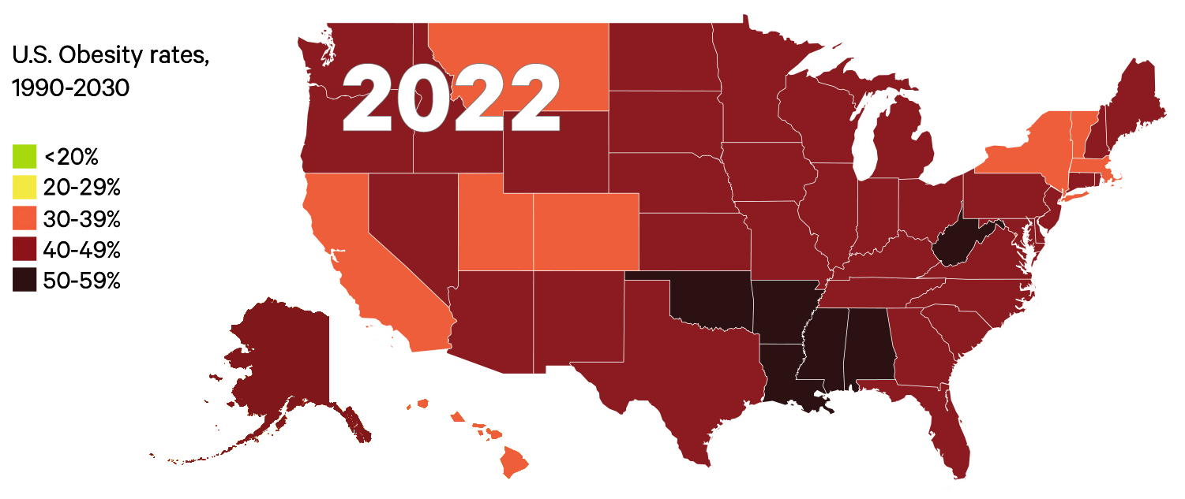
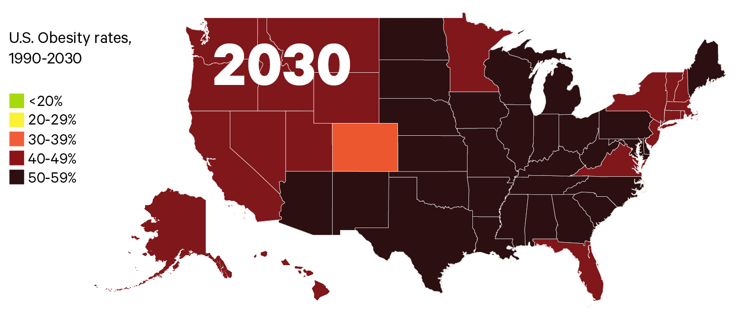
Nearly half of the US population will be obese by 2030
Nearly 1 in 3 adults (30.7%) are overweight
More than 2 in 5 adults (42.4%) have obesity
NHANES 1999-2018
Ward ZJ, NEJM 2019

Slide 7
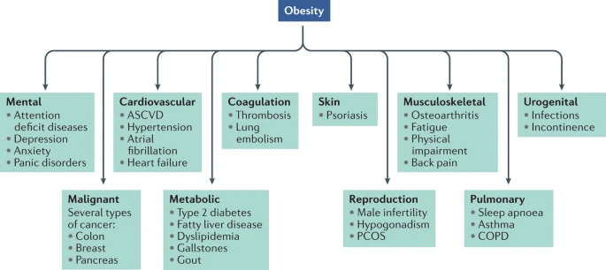
Obesity-Related Disorders
Müller Nature Reviews 2022

Slide 8

American Medical Association
AMA recognizes obesity as a disease state with multiple pathophysiological aspects requiring a range of interventions to advance obesity treatment and prevention since 2013

Slide 9
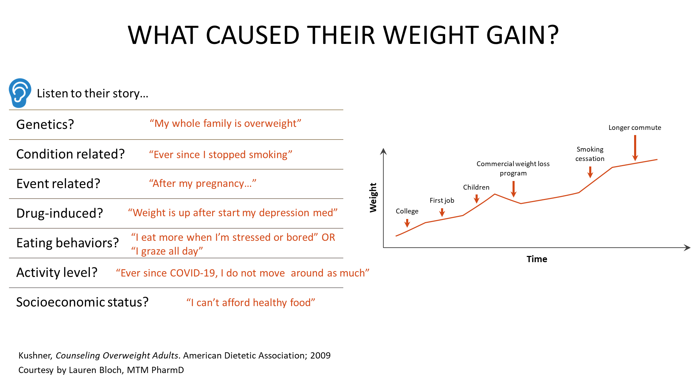

Slide 10


Slide 11
Challenges in Weight Loss
Complexity of energy regulation
Adaptive biological response to weight loss
  Fall in energy expenditure (out of proportion of reduction in body mass)
  Increase in appetite
  Changes in hormones
Dietary adherence is difficult

Slide 12
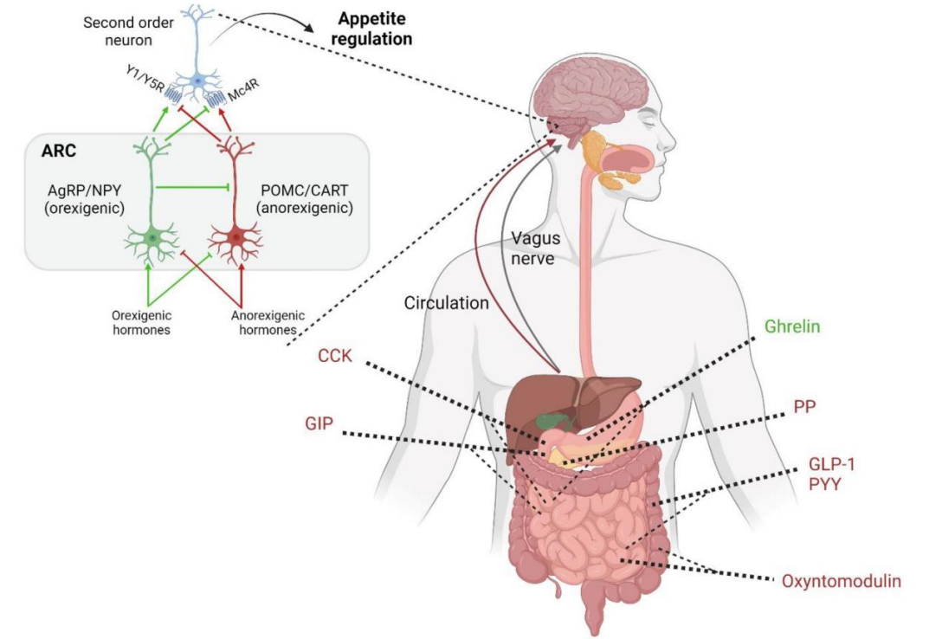
Regulation of Energy Balance is Complex

Slide 13
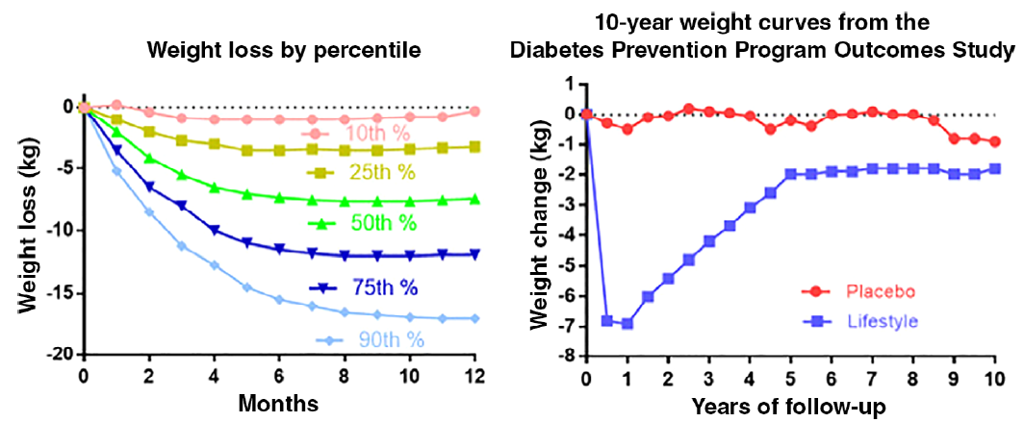
Weight Change with Lifestyle Intervention
Bray Diabetes Obes Metab. 2021

Slide 14


Slide 15
Weight Management Options
Bariatric
Surgery
Pharmacotherapy
Lifestyle Modifications
(diet, physical activity, behavioral modification)
BMI ≥ 35 with ≥ 1 co-morbidity
BMI ≥ 40 without co-morbidities
examples: hypertension, dyslipidemia, diabetes, OSA, osteoarthritis
BMI ≥ 27 with ≥ 1 co-morbidity
BMI ≥ 30 without co-morbidities
Continuum of Care
BMI ≥ 25
Modified from Lauren Bloch, MTM PharmD

Slide 16
Current Weight Loss Medication Options
Medications | FDA Approved for Weight Loss | Cost per month
Phentermine | 1959 | ~$15-$60*
Orlistat (Xenical®[Rx] or Alli®[OTC]) | 1999 (Xenical®) 2007 (Alli®) | RX: $680-$880 OTC: $40-$63
Phentermine/Topiramate (Qsymia®) | 2012 | $98-$185*
Naltrexone/Bupropion (Contrave®) | 2014 | $99-$150**
GLP-1 Agonists (Liraglutide, Semaglutide) GLP-1/GIP Agonist (Tirzepatide) | Saxenda® (2015) Wegovy® (2021 in adult and 2022 in children) Zepbound® (2023) | ~$950-$1500
* = dependent on strength and dosage form; **: price for IR tablet, ER often not covered for weight loss and expensive
Modified from Lauren Bloch, MTM PharmD

Slide 17


Weight Management Options:
Focus on GLP-1-based Therapy

Slide 18
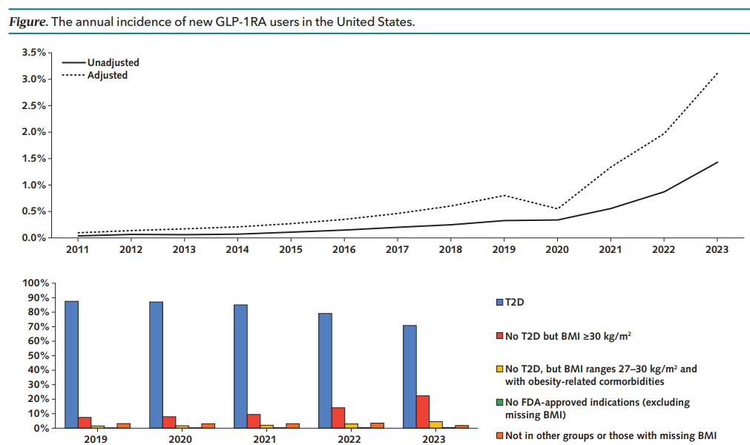
Surge in GLP1-RA prescription
- Annual trend in new prescriptions of GLP-1RAs between 2011 and 2023 from TriNetX database
- Increasing age- and sex-standardized incidence of new GLP-1RA use particularly after 2020
Yeo, Ann Intern Med 2024

Slide 19
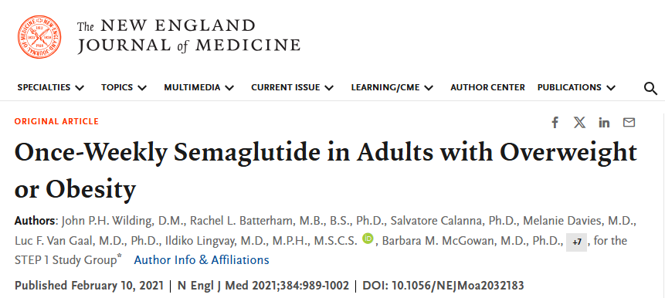
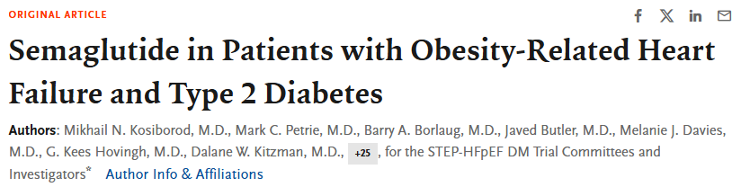
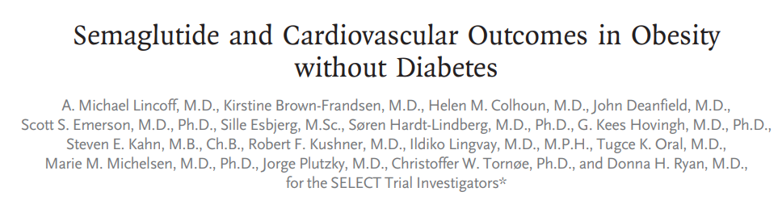
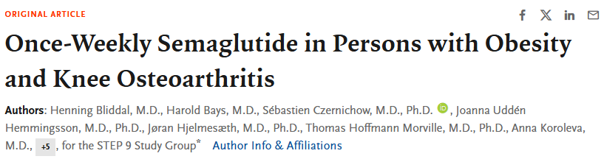
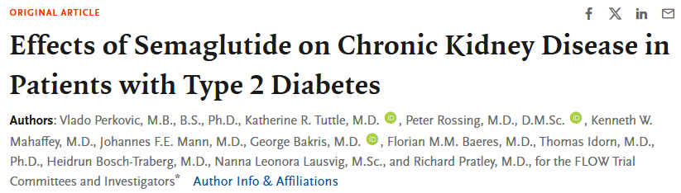
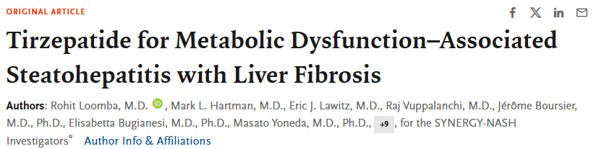
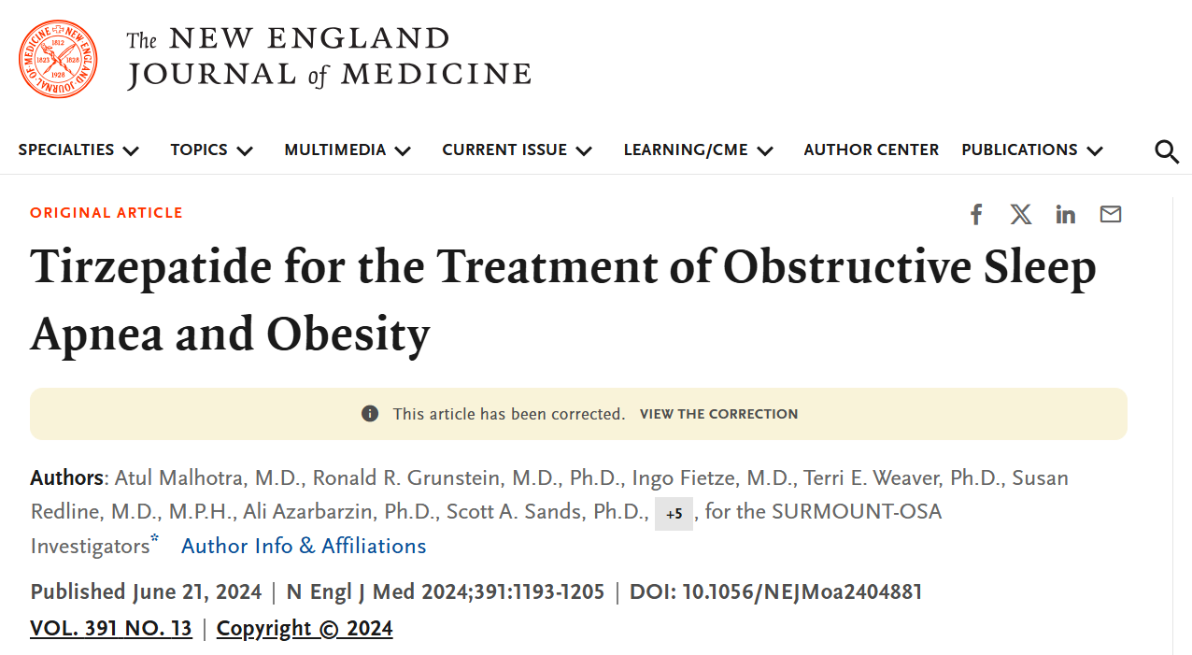

Slide 20
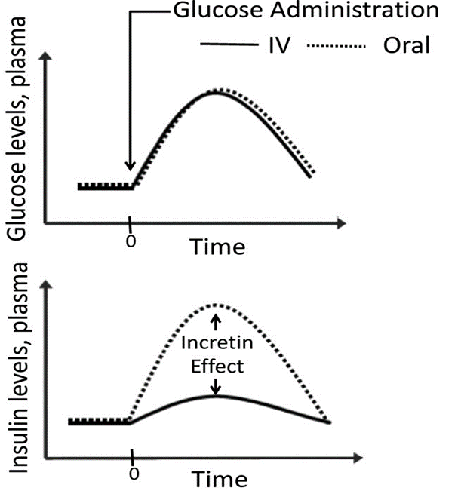
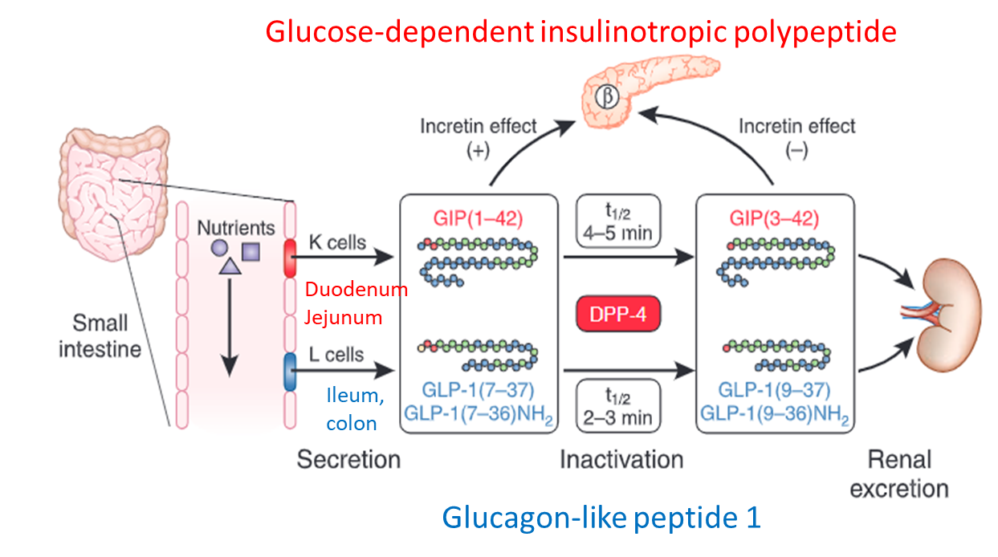
Incretin Hormones
GLP-1 and GIP are gut hormones that stimulate insulin secretion from pancreatic
beta-cells following a meal
Incretins stimulate meal-related insulin secretion from pancreas in a glucose-dependent manner
Seino, Diabetes Invest, 2010, Drucker Diabetologia 2023

Slide 21
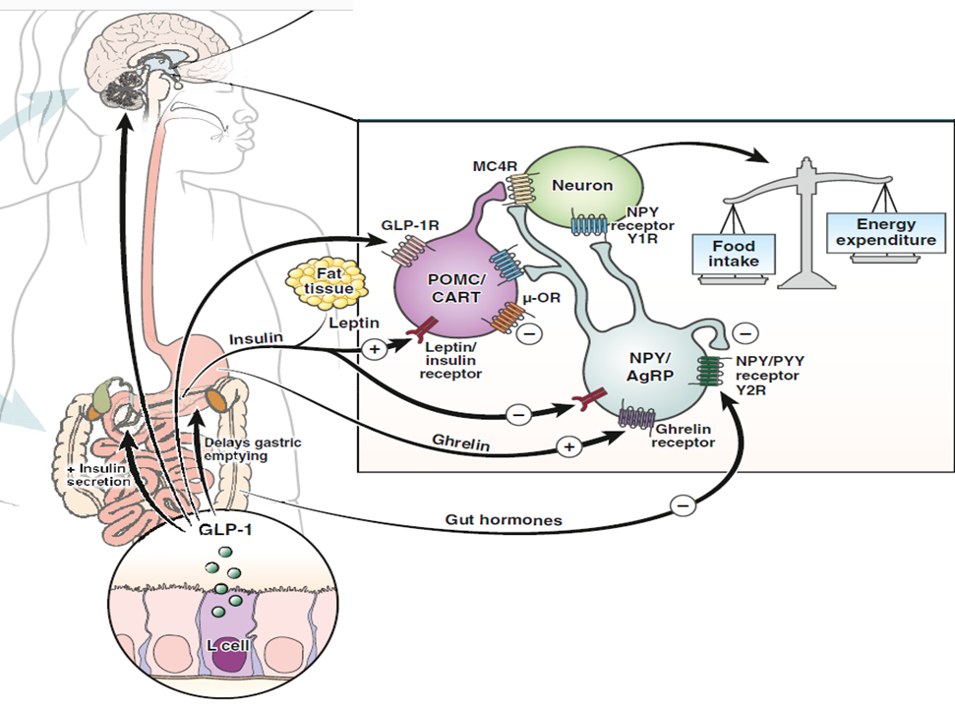
GLP-1 and Appetite Suppression
Central (hypothalamus) Reduced appetite: less hunger and food cravings
Peripheral mechanism:
- Delay both gastric emptying and gut motility
- Activation of gastric mechanoreceptors satiation signals relayed via the vagal nerves
Seino, Diabetes Invest, 2010;
Grunvald, Gastroenterology 2022

Slide 22
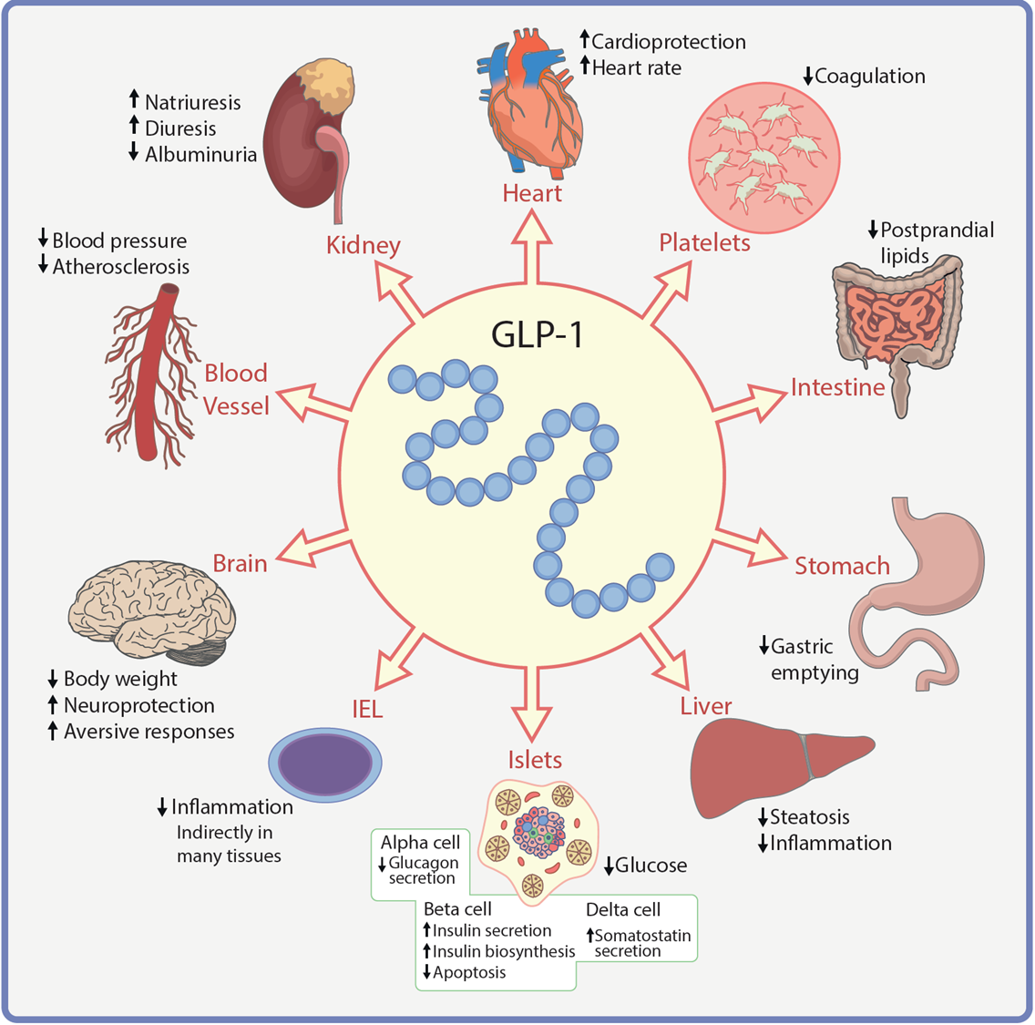
Key Metabolic Actions of GLP-1
Drucker and Holst Diabetologia 2023

Slide 23
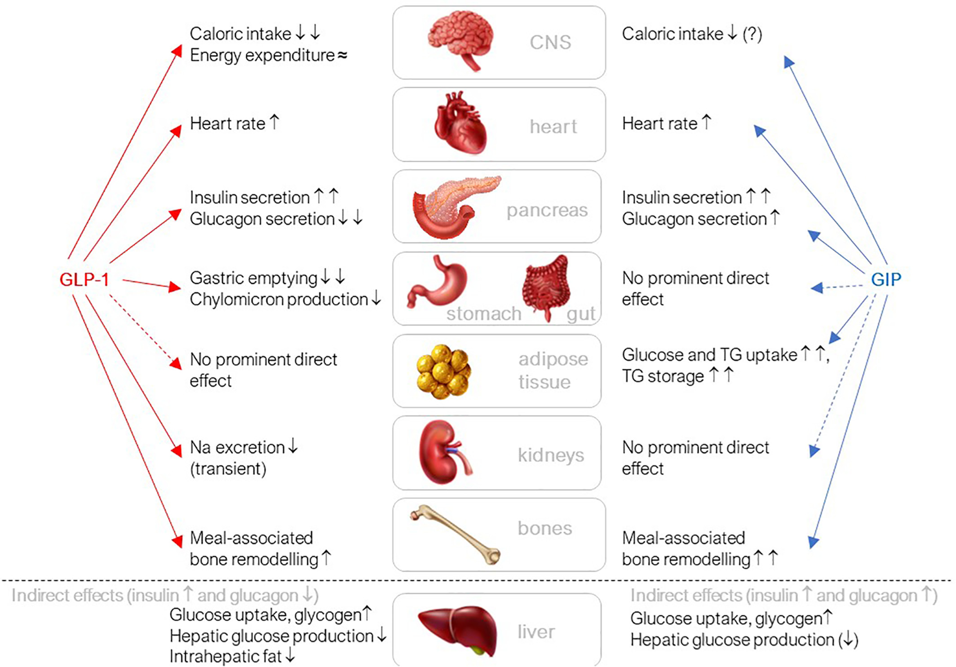
GLP-1 and GIP effects at the different organs
Nauck, Diabetes Obesity Metabolism, 2021

Slide 24
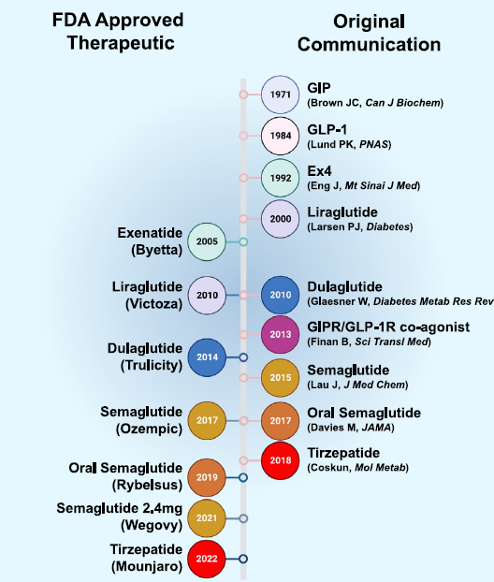
Timeline of the Discovery of
Incretin-based Therapies
Campbell, Cell Metabolism 2023

Slide 25
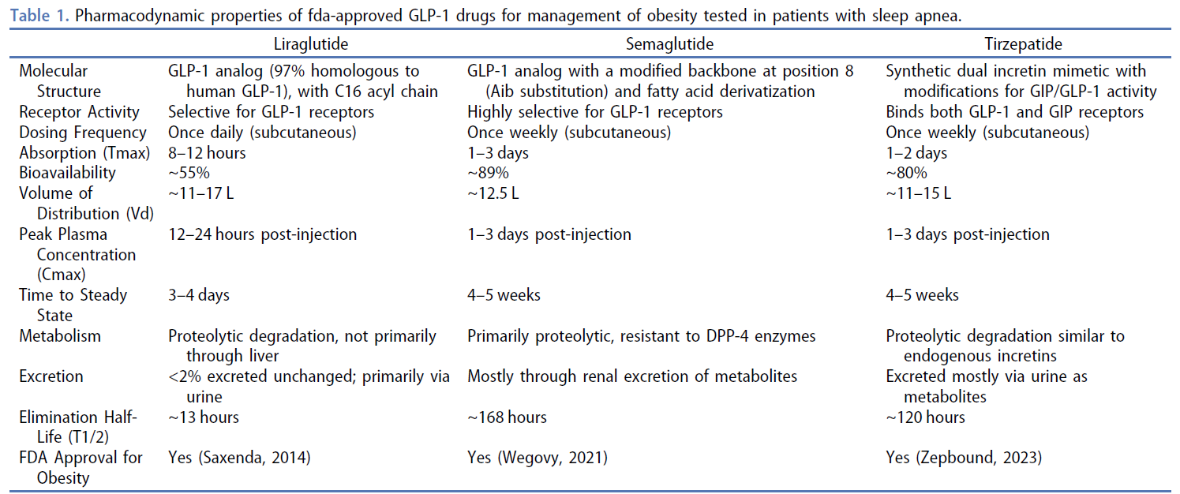
FDA approved GLP-1 based Treatment
El-Solh A, Expert Opinion on Pharmacotherapy 2025

Slide 26
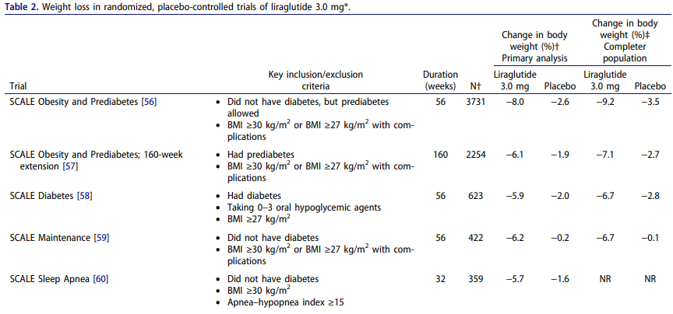
Liraglutide (SCALE Trials)
56-week, double-blind trial involving 3731 patients who did not have type 2 diabetes with BMI >30 or a BMI ≥ 27 with dyslipidemia or hypertension
Pi-Sunyer, NEJM 2015
Fitch Postgraduate Medicine 2021

Slide 27
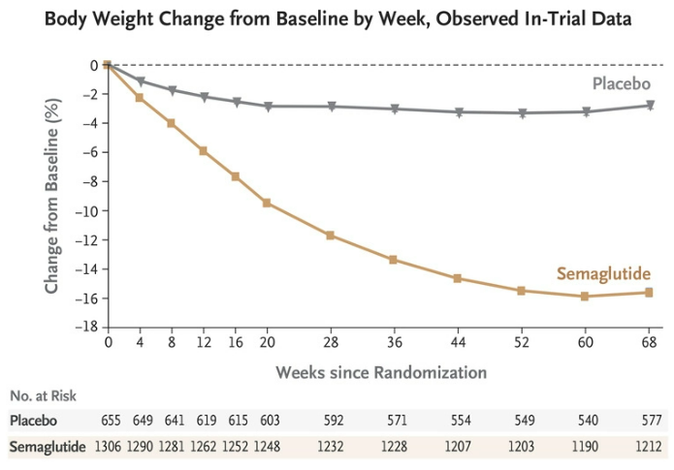
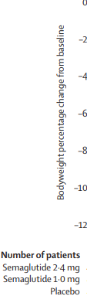
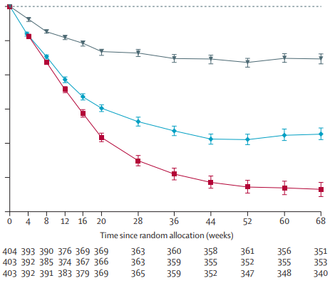
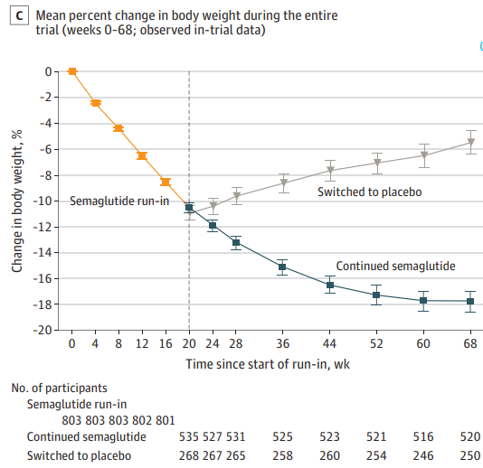
Semaglutide 2.4 mg (STEP Trials)
STEP 1
Obesity/overweight
without T2D
STEP 2
Obesity/overweight
with T2D
STEP 4
Obesity/overweight
without T2D
Stop med after 20 weeks
Wilding, Engl J Med 2021; Davies Lancet 2021; Rubino, JAMA 2021

Slide 28
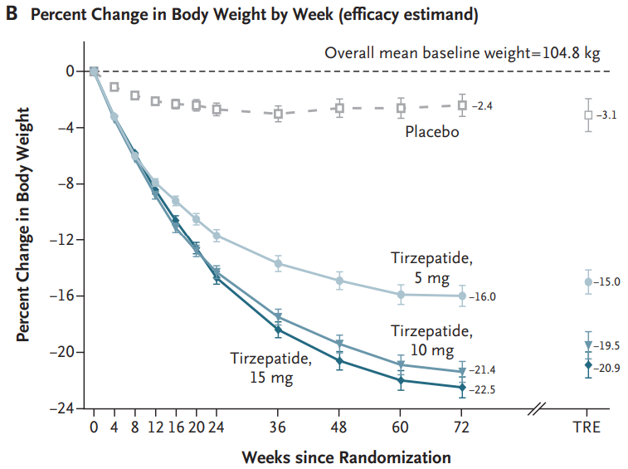
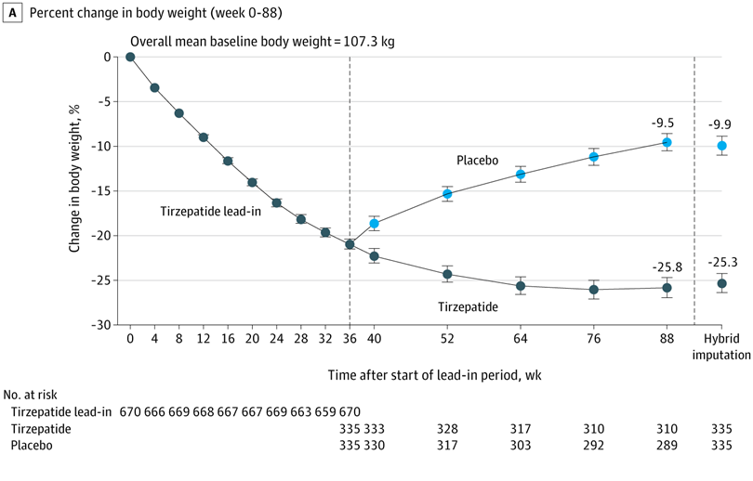
Tirzepatide (Surmount Trials)
Surmount-1
Obesity/overweight
without T2D
Surmount-4
Obesity/overweight
without T2D
Randomized at 36 weeks
Jastreboff NEJM 2022, Aronne JAMA 2023

Slide 29
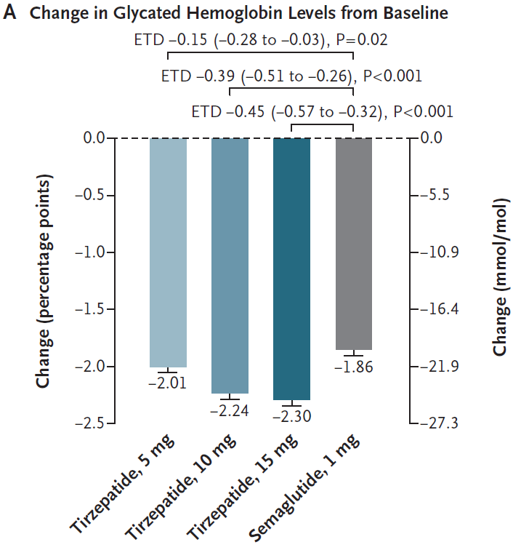
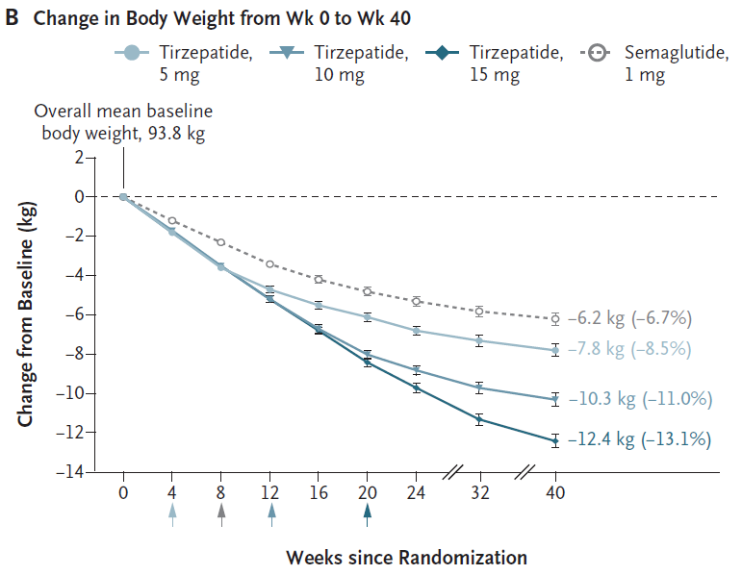
Tirzepatide vs Semaglutide in Type 2 Diabetes Trial
Direct comparison between Tirzepatide vs Semaglutide (weight loss dose) is anticipated 2025
Frias NEJM 2021

Slide 30
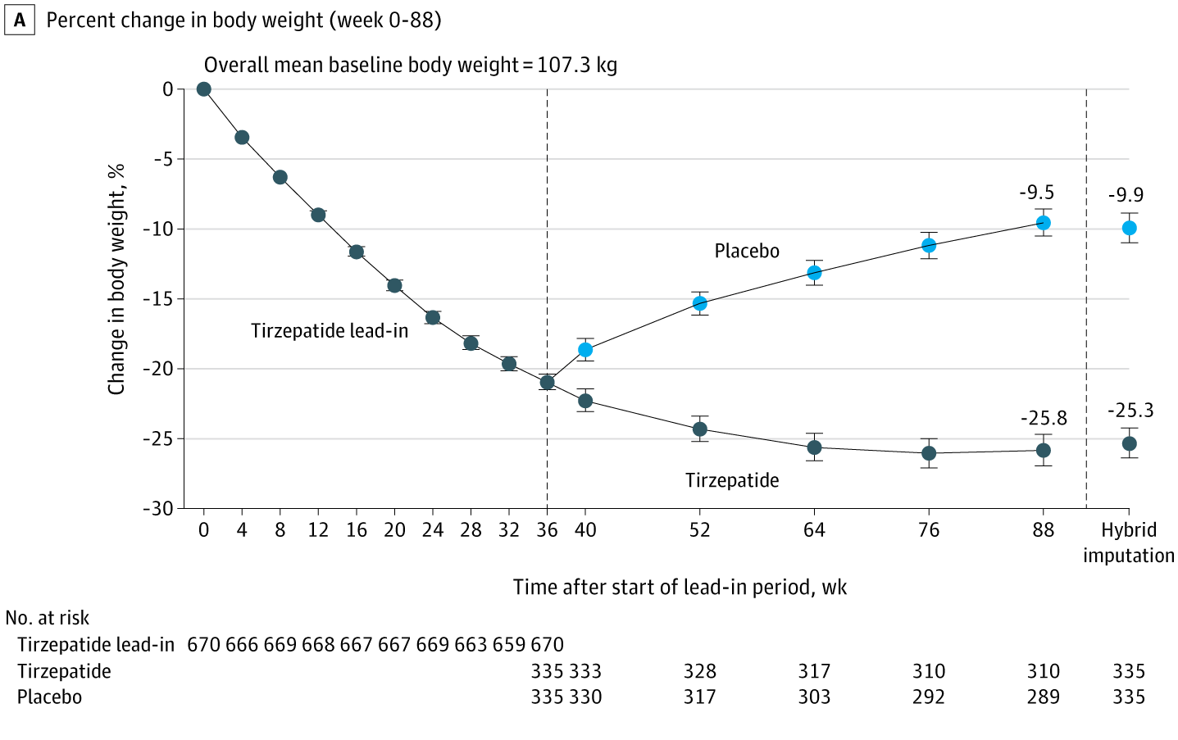
Withdrawing Tirzepatide led to Weight Regain
Surmount-4
Phase 3 RCT, randomized withdrawal trial
783 participants (average age 48 years; 90%<65 yo and 70% women)
Aronne, JAMA 2024

Slide 31
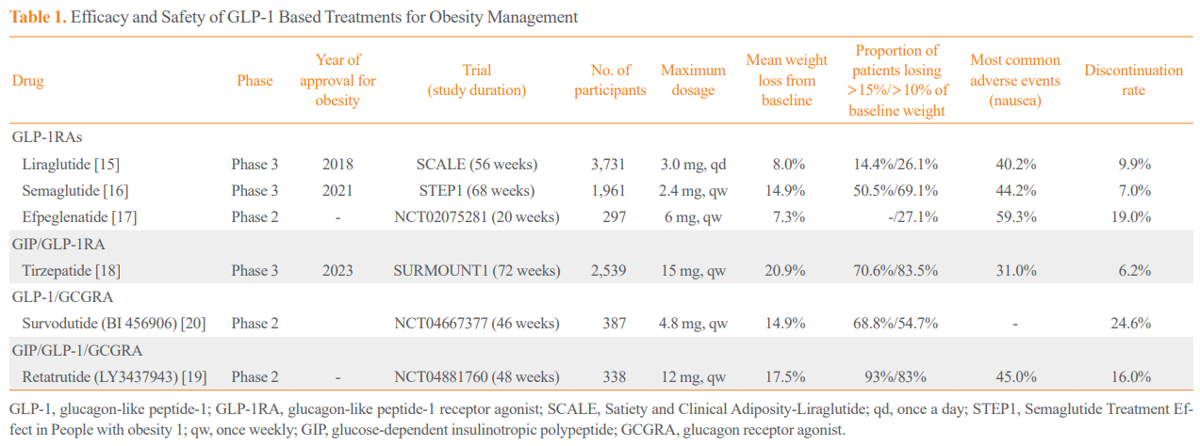
Summary of GLP-1 Treatments for Obesity
Son Endocrinol Metab 2024

Slide 32
Indications of GLP-1 based treatment
Approved for glycemic control in type 2 diabetes
  In type 2 diabetes with established cardiovascular disease and heart failure
  In type 2 diabetes with high risk of cardiovascular disease or chronic kidney disease
Approved for chronic weight management in patients with a BMI of ≥ 27 kg/m² or greater who have at least one weight-related conditions or in patients with a BMI ≥ 30 kg/m² or greater.
Approved for chronic weight management in children aged 12 years and older

Slide 33
GI Adverse Effects
Main adverse effects are gastrointestinal – nausea (~15-30%), vomiting (~5-10%), diarrhea, constipation (~10-15%), gastroparesis, bowel obstruction, biliary disease
Dose-dependent and class effect
Typically transient with mild to moderate intensity
Aroda, Diabetes Obes Metab. 2023
Wharton, POSTGRADUATE MEDICINE, 2022

Slide 34
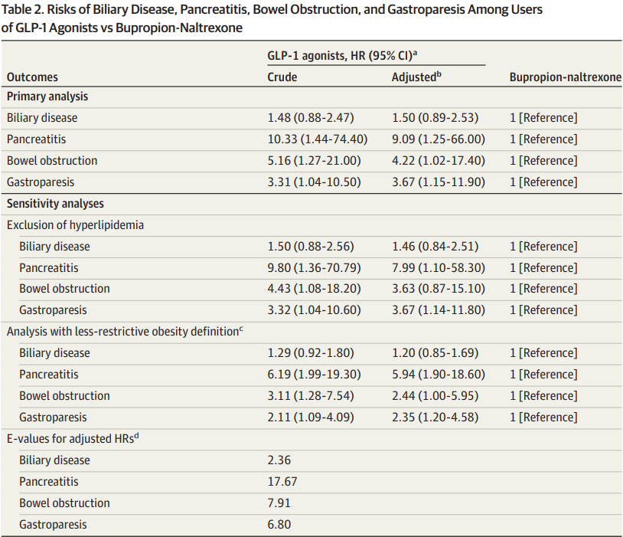
PharMetrics Plus -- Health Claims database (2006-2020) captured outpatient prescriptions for obesity (excluded diabetes) in Canada
4144 liraglutide, 613 semaglutide, and 654 bupropion-naltrexone users.
Sodhi JAMA 2023

Slide 35
Pancreatitis Risk
Current data of acute pancreatitis secondary to specifically GLP-1+/- GIP agonist is inconsistent
Acute pancreatitis has been reported but large CVOT trials have not shown an increased risk.
FDA warnings exist for acute pancreatitis with GLP-1 RAs, but no definitive causal link has been established.
Pancreatitis is more common in type 2 diabetes and hypertriglyceridemia than general population
Consider use on case-by-case basis with shared decision with the patients

Slide 36
Other potential side effects
GLP-1 may reduce opioid overdose risk in patients with comorbid T2D and opioid overdose risk
Suicidal risk
  European Medicines Agency received reports of suicidal thoughts and self-injury associated with liraglutide and semaglutide in 2023
    FDA Adverse Event Reporting System (FAERS) found no causal link between GLP-1 RAs and suicidality
May worsening diabetic retinopathy
FDA 01-11-2024 FDA Drug Safety Communication
McIntyre, EXPERT OPINION ON DRUG SAFETY, 2023

Slide 37
Concern for Medullary Thyroid Carcinoma and
Multiple Endocrine Neoplasia-2 (MEN-2)
GLP-1 and GLP-1/GIP agonists are contraindicated in patients with personal or family history of MTC and MEN-2
Parafollicular cells express GLP-1 receptors
Data from rodents exposed to GLP-1 agonists developed C-cell hyperplasia, including MTC
  Doses given of GLP-1 agonist in rodents were higher than human trials
  Rodents have higher density of GLP-1 receptors on thyroid C-cells compared to humans
Human trials have not consistently demonstrated increased risk of MTC in GLP-1 agonist use
  No increased thyroid cancer in large CVOT trials
  Observational data and meta-analysis data are not consistent.
Routine thyroid monitoring is not recommended unless clinically indicated.

Slide 38
GLP-1RA and Pregnancy
Classified as pregnancy class C medications as they have been shown to cross the placenta and cause fetal growth restriction and congenital anomalies in animals.
The literature regarding the length of discontinuation of GLP-1 RA before conception is inconsistent
Large observational multicenter study found exposure to GLP1-RA in the periconceptional period was not associated with a risk of major birth defects
Minis Curr Opin Endocrinol Diabetes Obes 2023
Cesta JAMA Intern Med 2024

Slide 39
What to do when starting GLP-1 treatment
Start low, Go slow
  Gradual dose escalation reduces GI symptoms
  Pause dose escalation until GI symptoms improve
Minimize meal size, avoid fatty/rich/greasy foods to mitigate GI issues
GLP1/GIP dual treatment has shown to reduce GI side effects compared to GLP-1 alone
Stay hydrated - keep up with water intake, ~64-96 oz water per day
Increase dietary fiber slowly (25+ grams/day, start fiber supplementation if unable to reach fiber goals), and Miralax if constipated

Slide 40
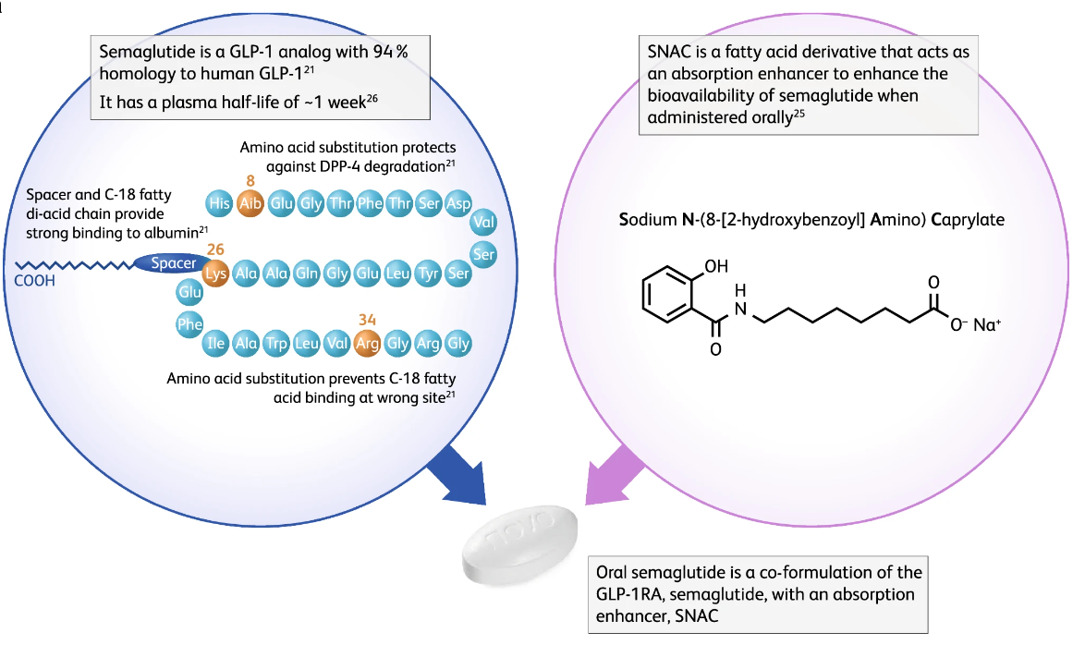
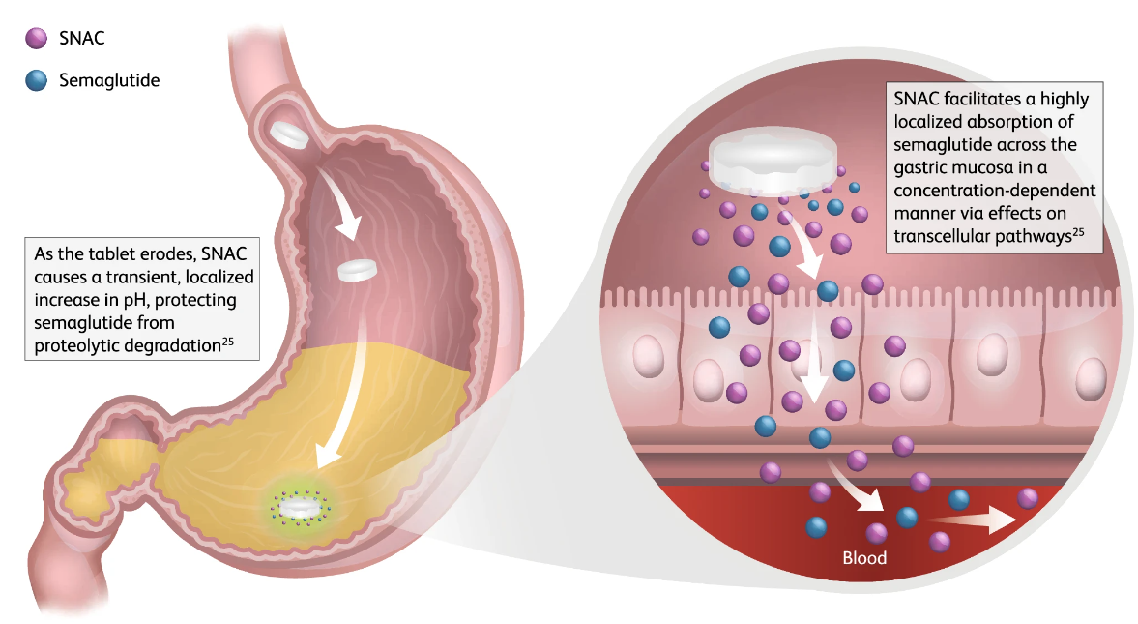
Oral Semaglutide
High dose oral semaglutide (25-50 mg) for treatment of obesity without type 2 diabetes
OASIS-1 trial – 15% mean weight loss with oral semaglutide vs -2.4% with placebo
Knop, Lancet 2023

Slide 41
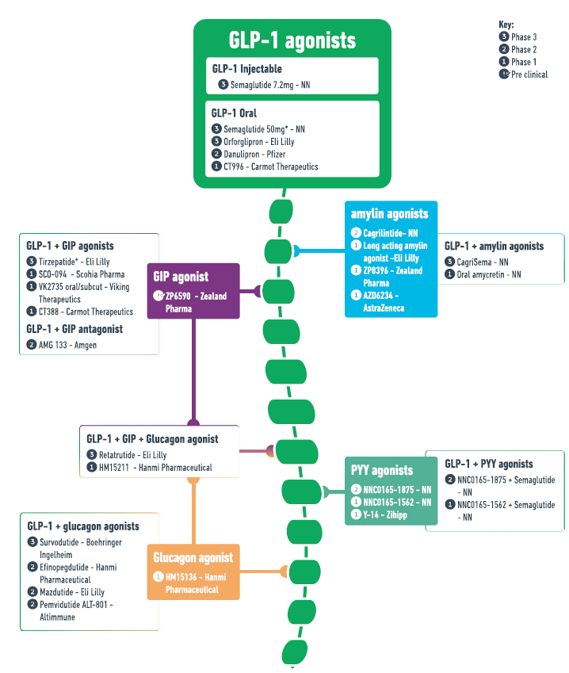
New GLP-1 based Therapy
GLP-1 is the backbone of the pipeline for gut hormone-based obesity treatments
Mono-agonist, dual-agonist and triple-agonist
Melson, International Journal of Obesity, 2024

Slide 42



Slide 43
Weight Loss Medication Assessment
Timeline
Month 0
Start weight loss medication (WLM)
Monthly Check In For First 3 Months
Assess efficacy and safety
Effective (weight loss ≥ 5% body weight from baseline)* → continue WLM
Ineffective (weight loss <5% body weight from baseline)* OR safety/tolerability concerns → dose change or discontinue & consider alternative
If safety/tolerability/efficacy concerns → Reassess regimen and make changes as necessary
Every 3 Months Thereafter
Continue to assess for efficacy and safety
3 Months After Starting WLM
^{*General guide, efficacy}
determined per provider discretion
Courtesy by Lauren Bloch, MTM PharmD
Notes:
Following Endocrine Society Clinical Practice Guidelines suggest close monitoring where monthly monitoring is necessary after starting weight loss medication(s) for the first 3 months to assess efficacy and safety. Then at 3 months, assess if weight loss medication is considered “effective” or “ineffective” for weight loss. If not effective, then stop/taper and choose alternative option. If effective, may continue the regimen with continued monitoring every 3 months.

Slide 44
Take Home Messages
Obesity is a chronic disease
Medications are used as an adjunct to nutritional/lifestyle modification
GLP-1/GIP based medications are increasingly popular medications approved for the treatment of obesity and type 2 diabetes
GLP1/GIP receptor are widely expressed in multiple organs so it has pleiotropic effect
  Glucose lowering effects – stimulate beta cell function
  Reduction of glucagon secretion
  Delay gastric emptying time
  Induce satiety
  Beneficial effect on cardiovascular risk, renal progression, CNS (neurodegenerative) and possible fertility benefit

Slide 45
Take Home Messages
Medications require close monitoring for safety and efficacy
Several barriers in prescribing GLP-1/GIP medication
  Side effects
  Cost and lack of consistent, and complete insurance coverage
Several challenges on successful weight loss
  Adaptive biological response to weight loss
  Weight maintenance requires lifelong attention
  Cognitive and behavioral reinforcement require to maintain long-term lifestyle modification

Slide 46
Thank you for your attention hari0049@umn.edu

